Slide 1
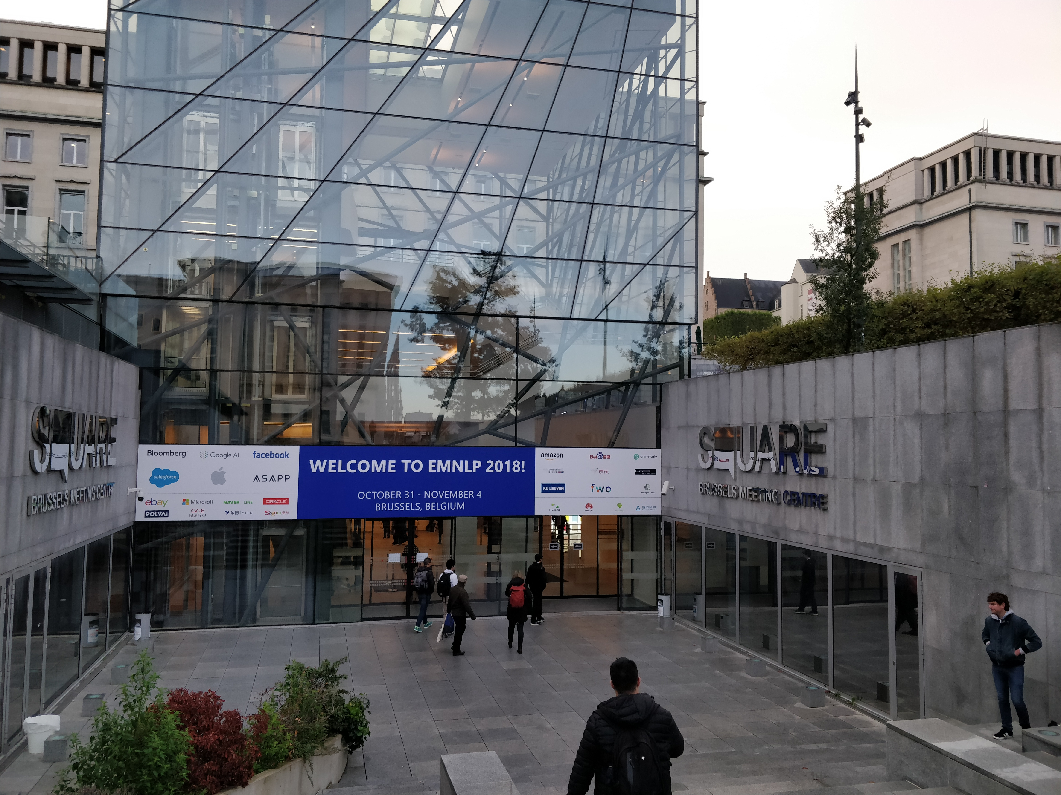
My Impressions of EMNLP 2018
Aditya Joshi
Postdoctoral Research Fellow, Data61, CSIRO
aditya.joshi@csiro.au
https://github.com/adityajo/ConferenceReports
Disclaimer: This presentation is only a summary of what I saw, understood, and remember.
Conference Venue

Slide 2
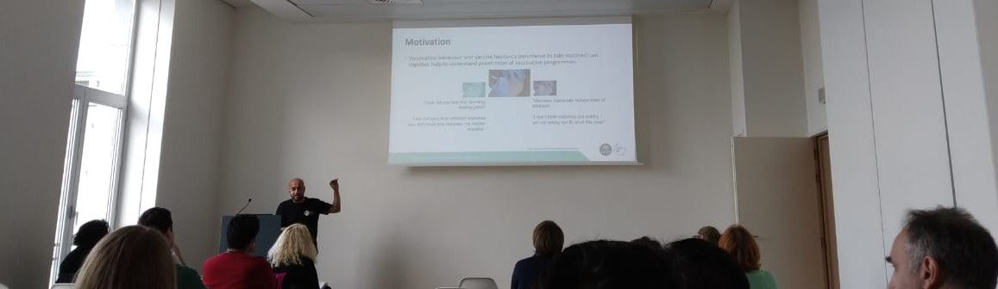
Introduction
When: 2nd – 4th November 2018
Where: Square Brussels Meeting Centre, Brussels, Belgium
What else: Workshop on social media mining for health applications on 31st October 2018
From SMM4H workshop

Slide 3
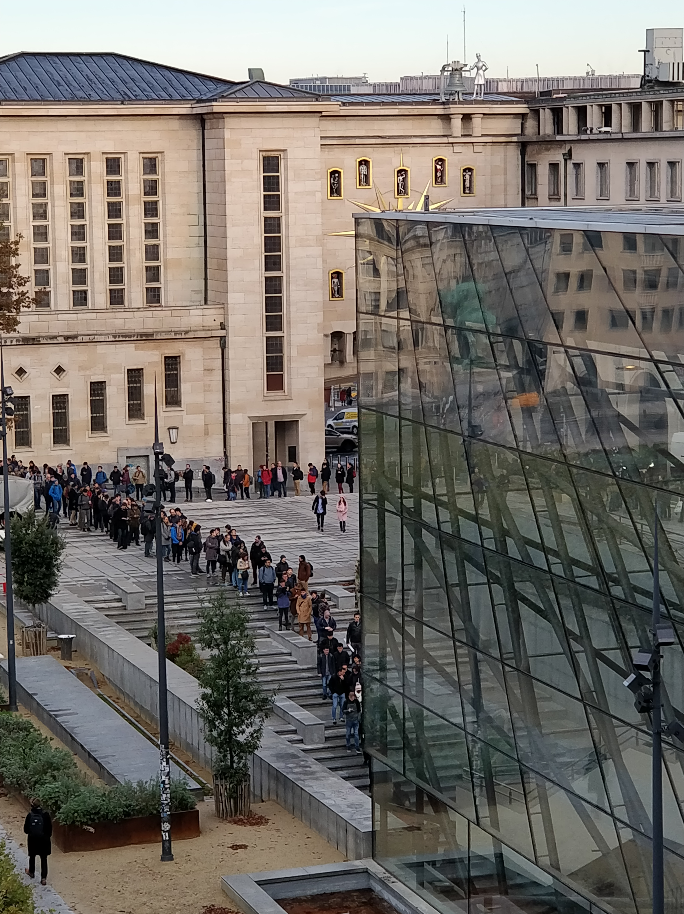
Inaugural session
Queue at the conference venue
Ellen Riloff
Submissions up by 46%
Similar acceptance rates (~24%, 10% of each category selected for oral presentation)
2500 registrations (100% increase over last year)
Social event dinner at two venues
Ticket exchange baskets

Slide 4
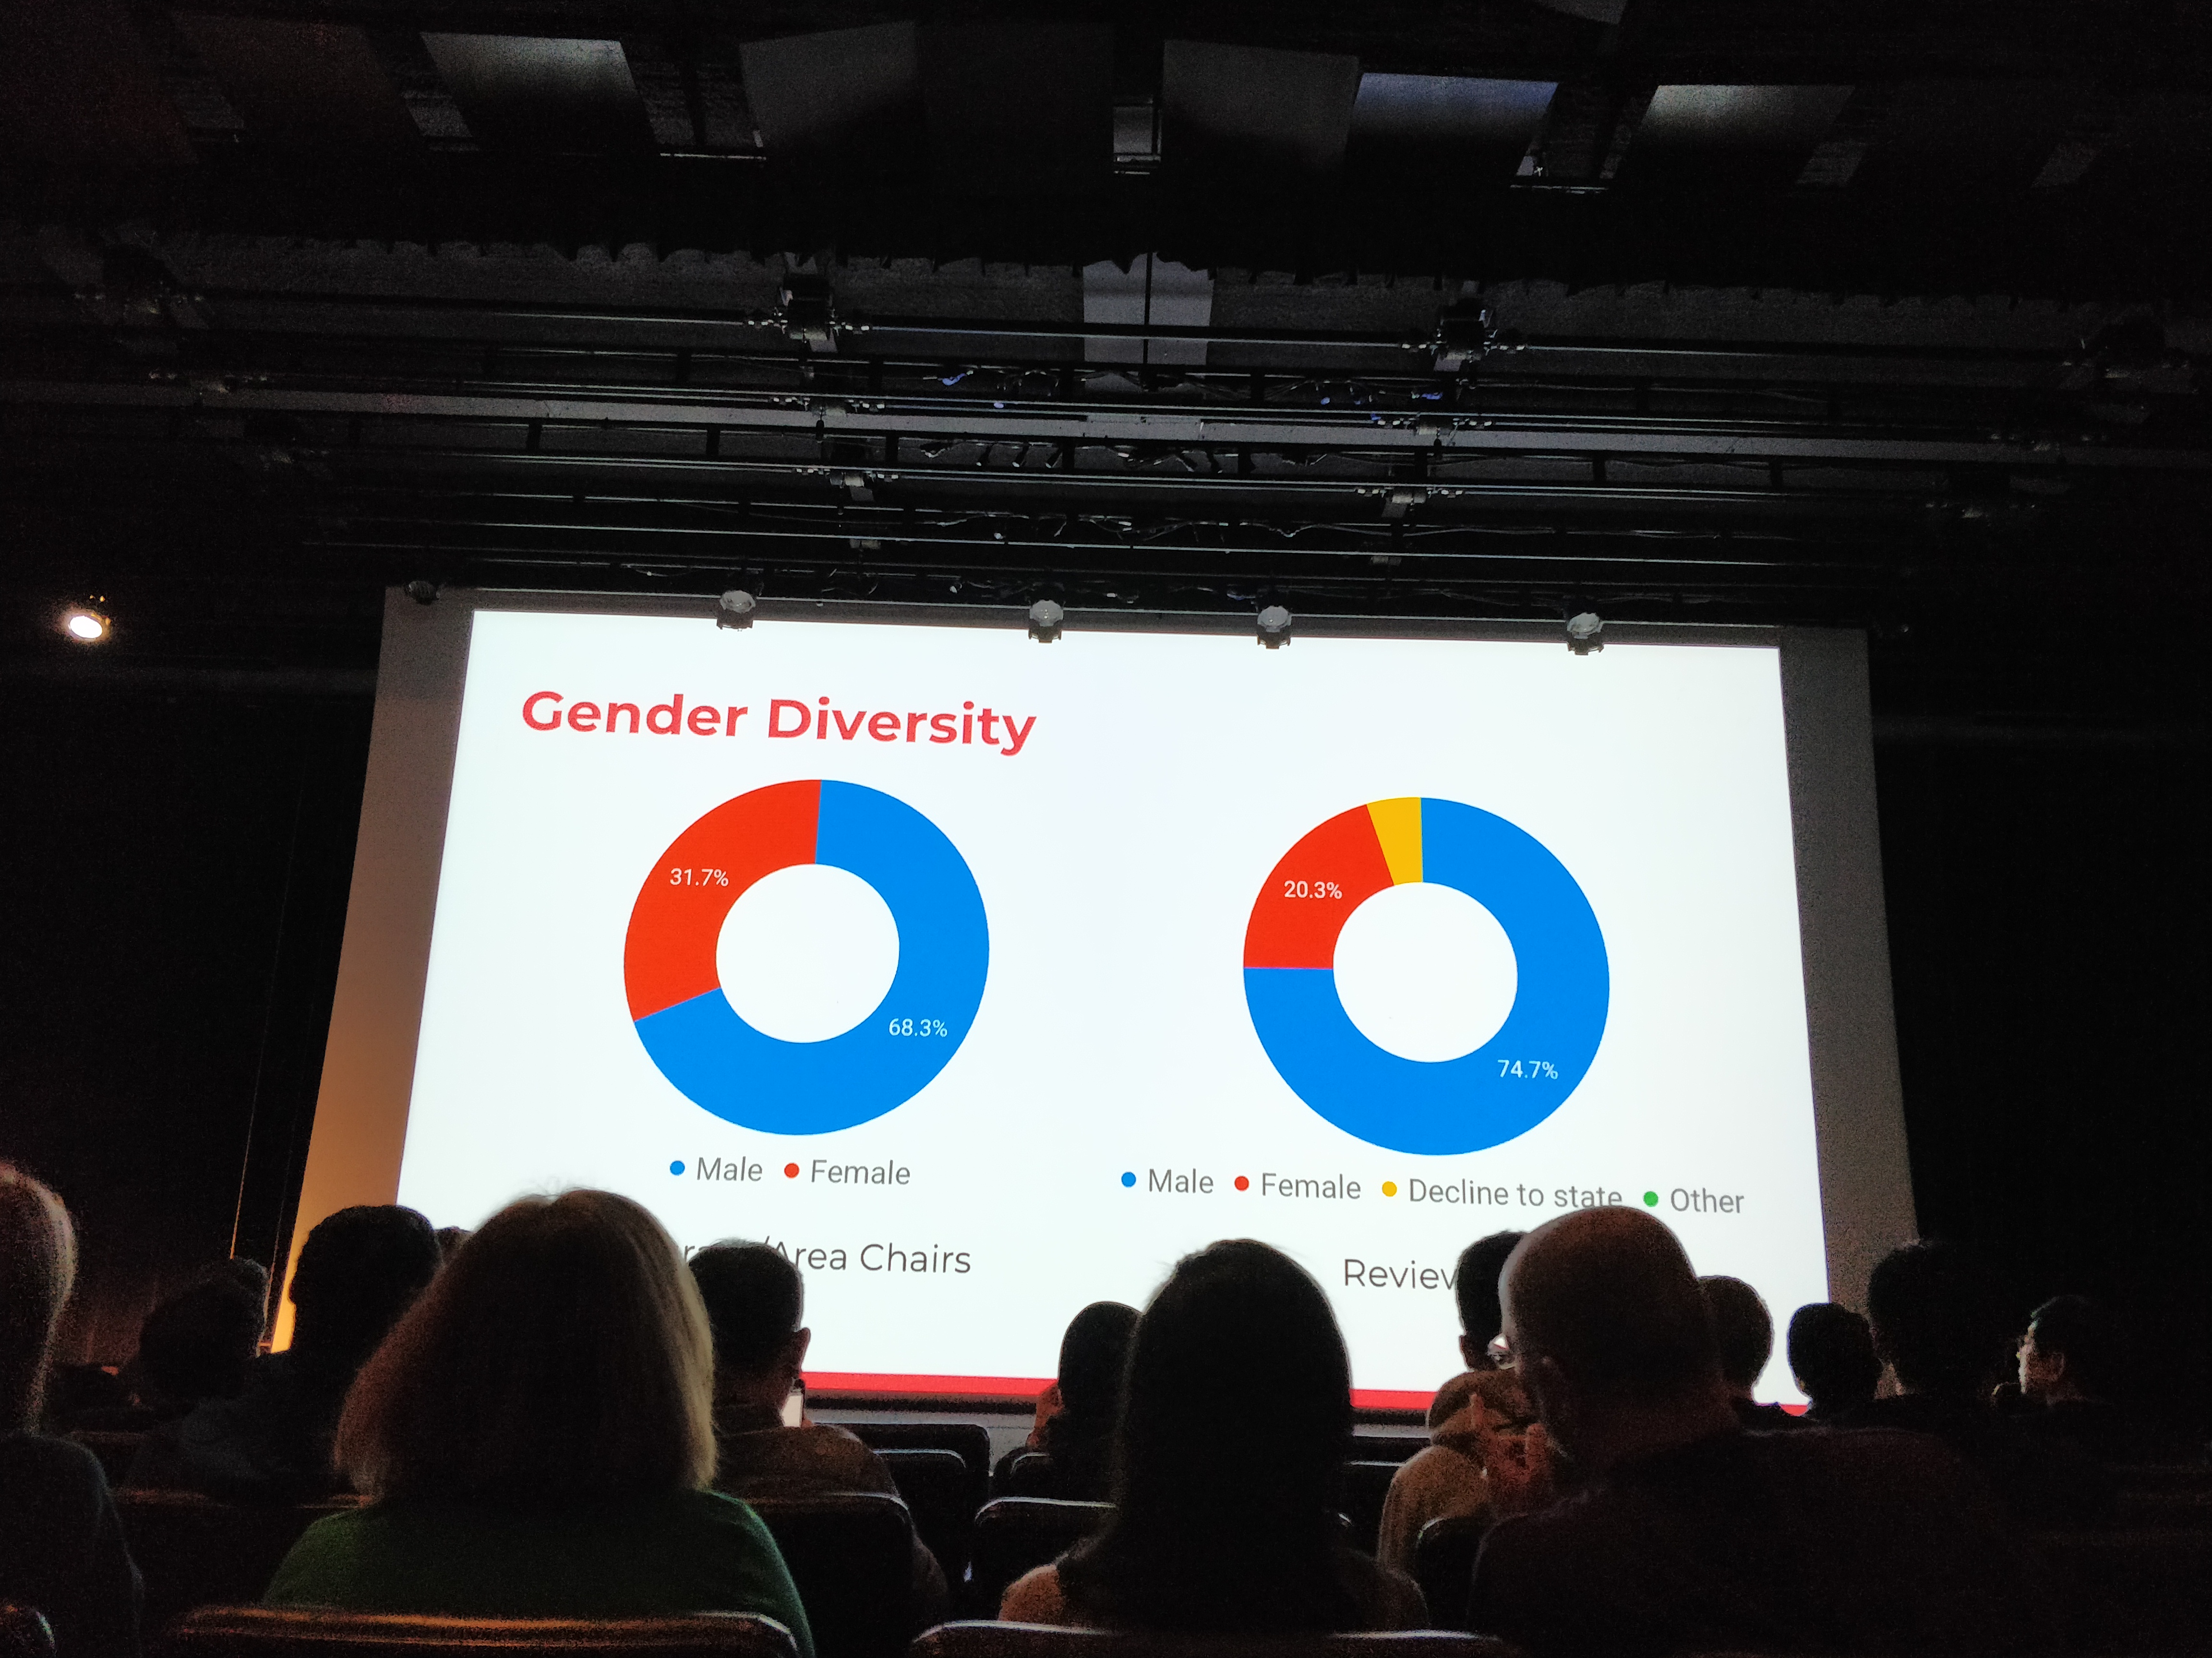
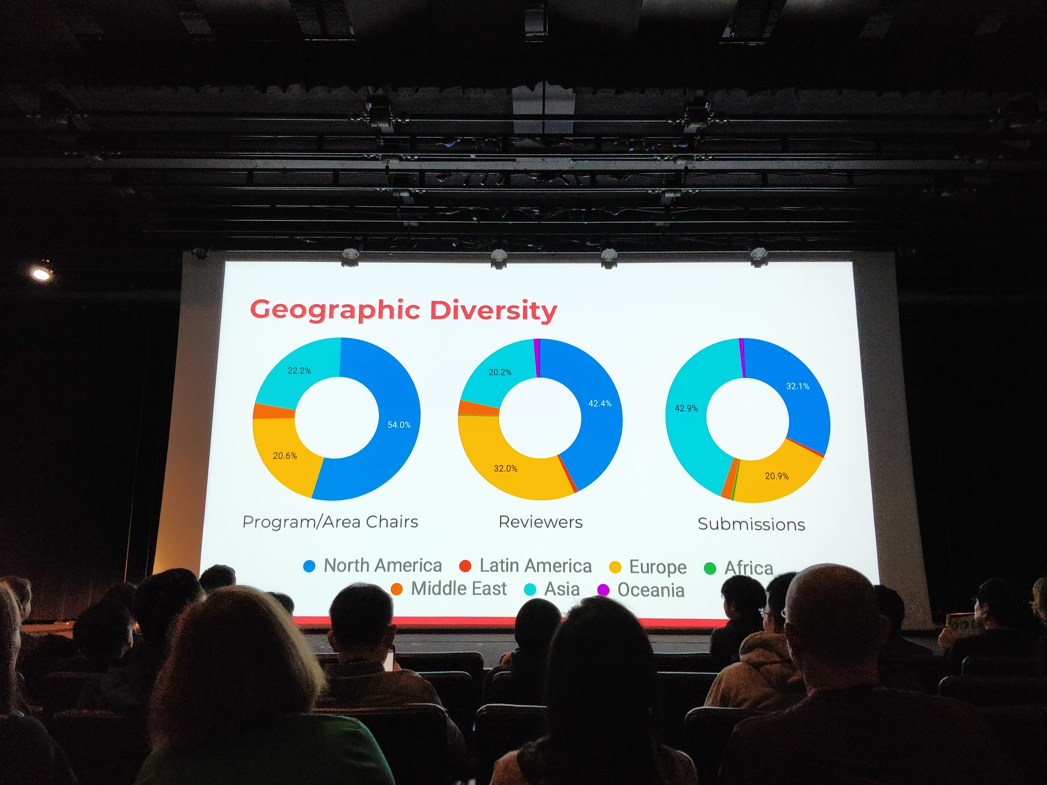
From Inaugural session
From Inaugural session

Slide 5
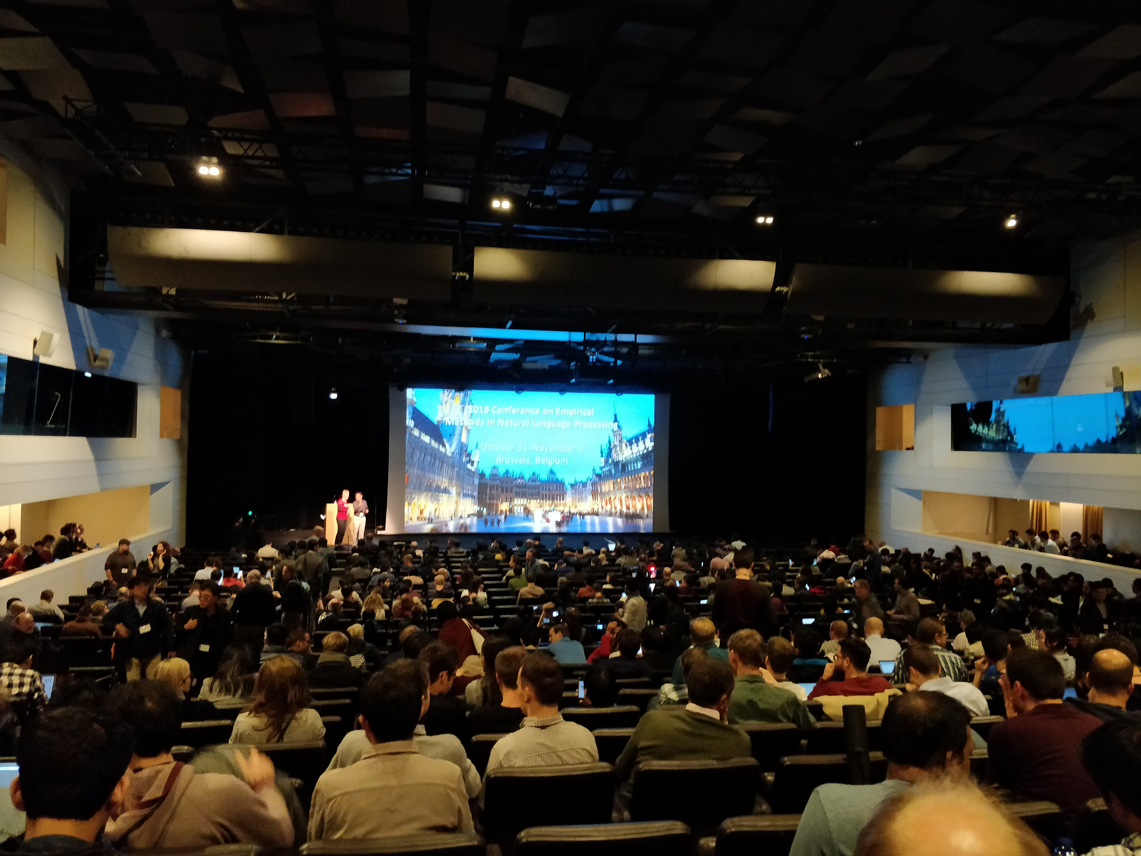
Plenary talks
Plenary talk 2

Slide 6
Plenary talk 1
Talk by Julia Hirschberg on ‘deception detection in speech’
Projects for various government agencies in the US
Motivation (studies with different professions)
Interesting human experiments: Questionnaires, Keystrokes, Monetary rewards
Linguistic and acoustic (OpenSmile?) features
ML models could beat human performance

Slide 7
Plenary talk 2
Talk by Gideon Mann, Head of Data Science at Bloomberg
‘News moves markets’: News Analytics
Within milliseconds of publishing a news, the stock market changes.
First to break a news also matters.
1) Detection: Detecting a breaking news... Impact of fake news on stock market....
(Explosions in white house and Obama injured)
(Geolocation credibility.. building trajectory of where someone has been to predict if the person is likely to have been at a location.)
2) Extraction: entity extraction. Finance markets is difficult because it can be fine grained and can have point in time granularity. He showed an ontology example.
3) Interpretation: Will detection/extraction step result in increase or decrease?
4) Presentation: Visualisation

Slide 8
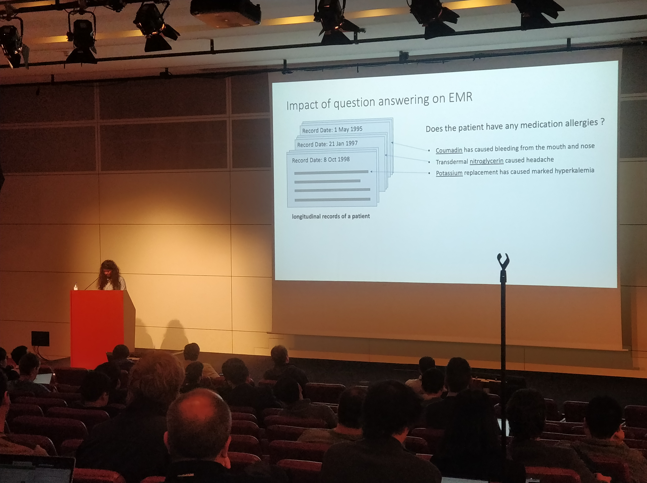
Health-related papers
An oral presentation

Slide 9
Health-related papers from SMM4H
Identifying depression on reddit: The effect of training data
Role of training data
Specifically, the meaning of the ‘negative class’
Changes in psycholinguistic attributes
Consider the set of authors who reported flu-like symptoms
Download their tweets 3 weeks before and after the reports
Analyse the tweets for psycholinguistic attributes
Blood donation request detection
Classify a tweet containing ‘blood’/’donate’ as blood donation request or not
Medical non-adherence detection
Detect a tweet as a case of medical non-adherence or not

Slide 10
Multi-view embeddings for dementia detection
What?
Dementia affects memory and language. Signals from language can be used for early detection of dementia
Two kinds of participants.. patients and healthy. Each patient participant has a score.
Participants participate in three tasks: (a) describes in words, (b) think of words that begin with a letter, (c) Think of words that belong to a category (e.g. animal)
How?
Extract lots of features from the three experiments
Generalized canonical correlation analysis... Turn different features into some sort of distributional representation.
Random forest with 100 decision trees.
Two tasks: (a) Binary classification, (b) score prediction

Slide 11
QA for medical records
emrQA: QA for medical records
Questions on medical records... With rules to generate answers. Rules have been generated by physicians. Use schema to generate patterns of q and a.
Transcripts + Questions -- Answers

Slide 12
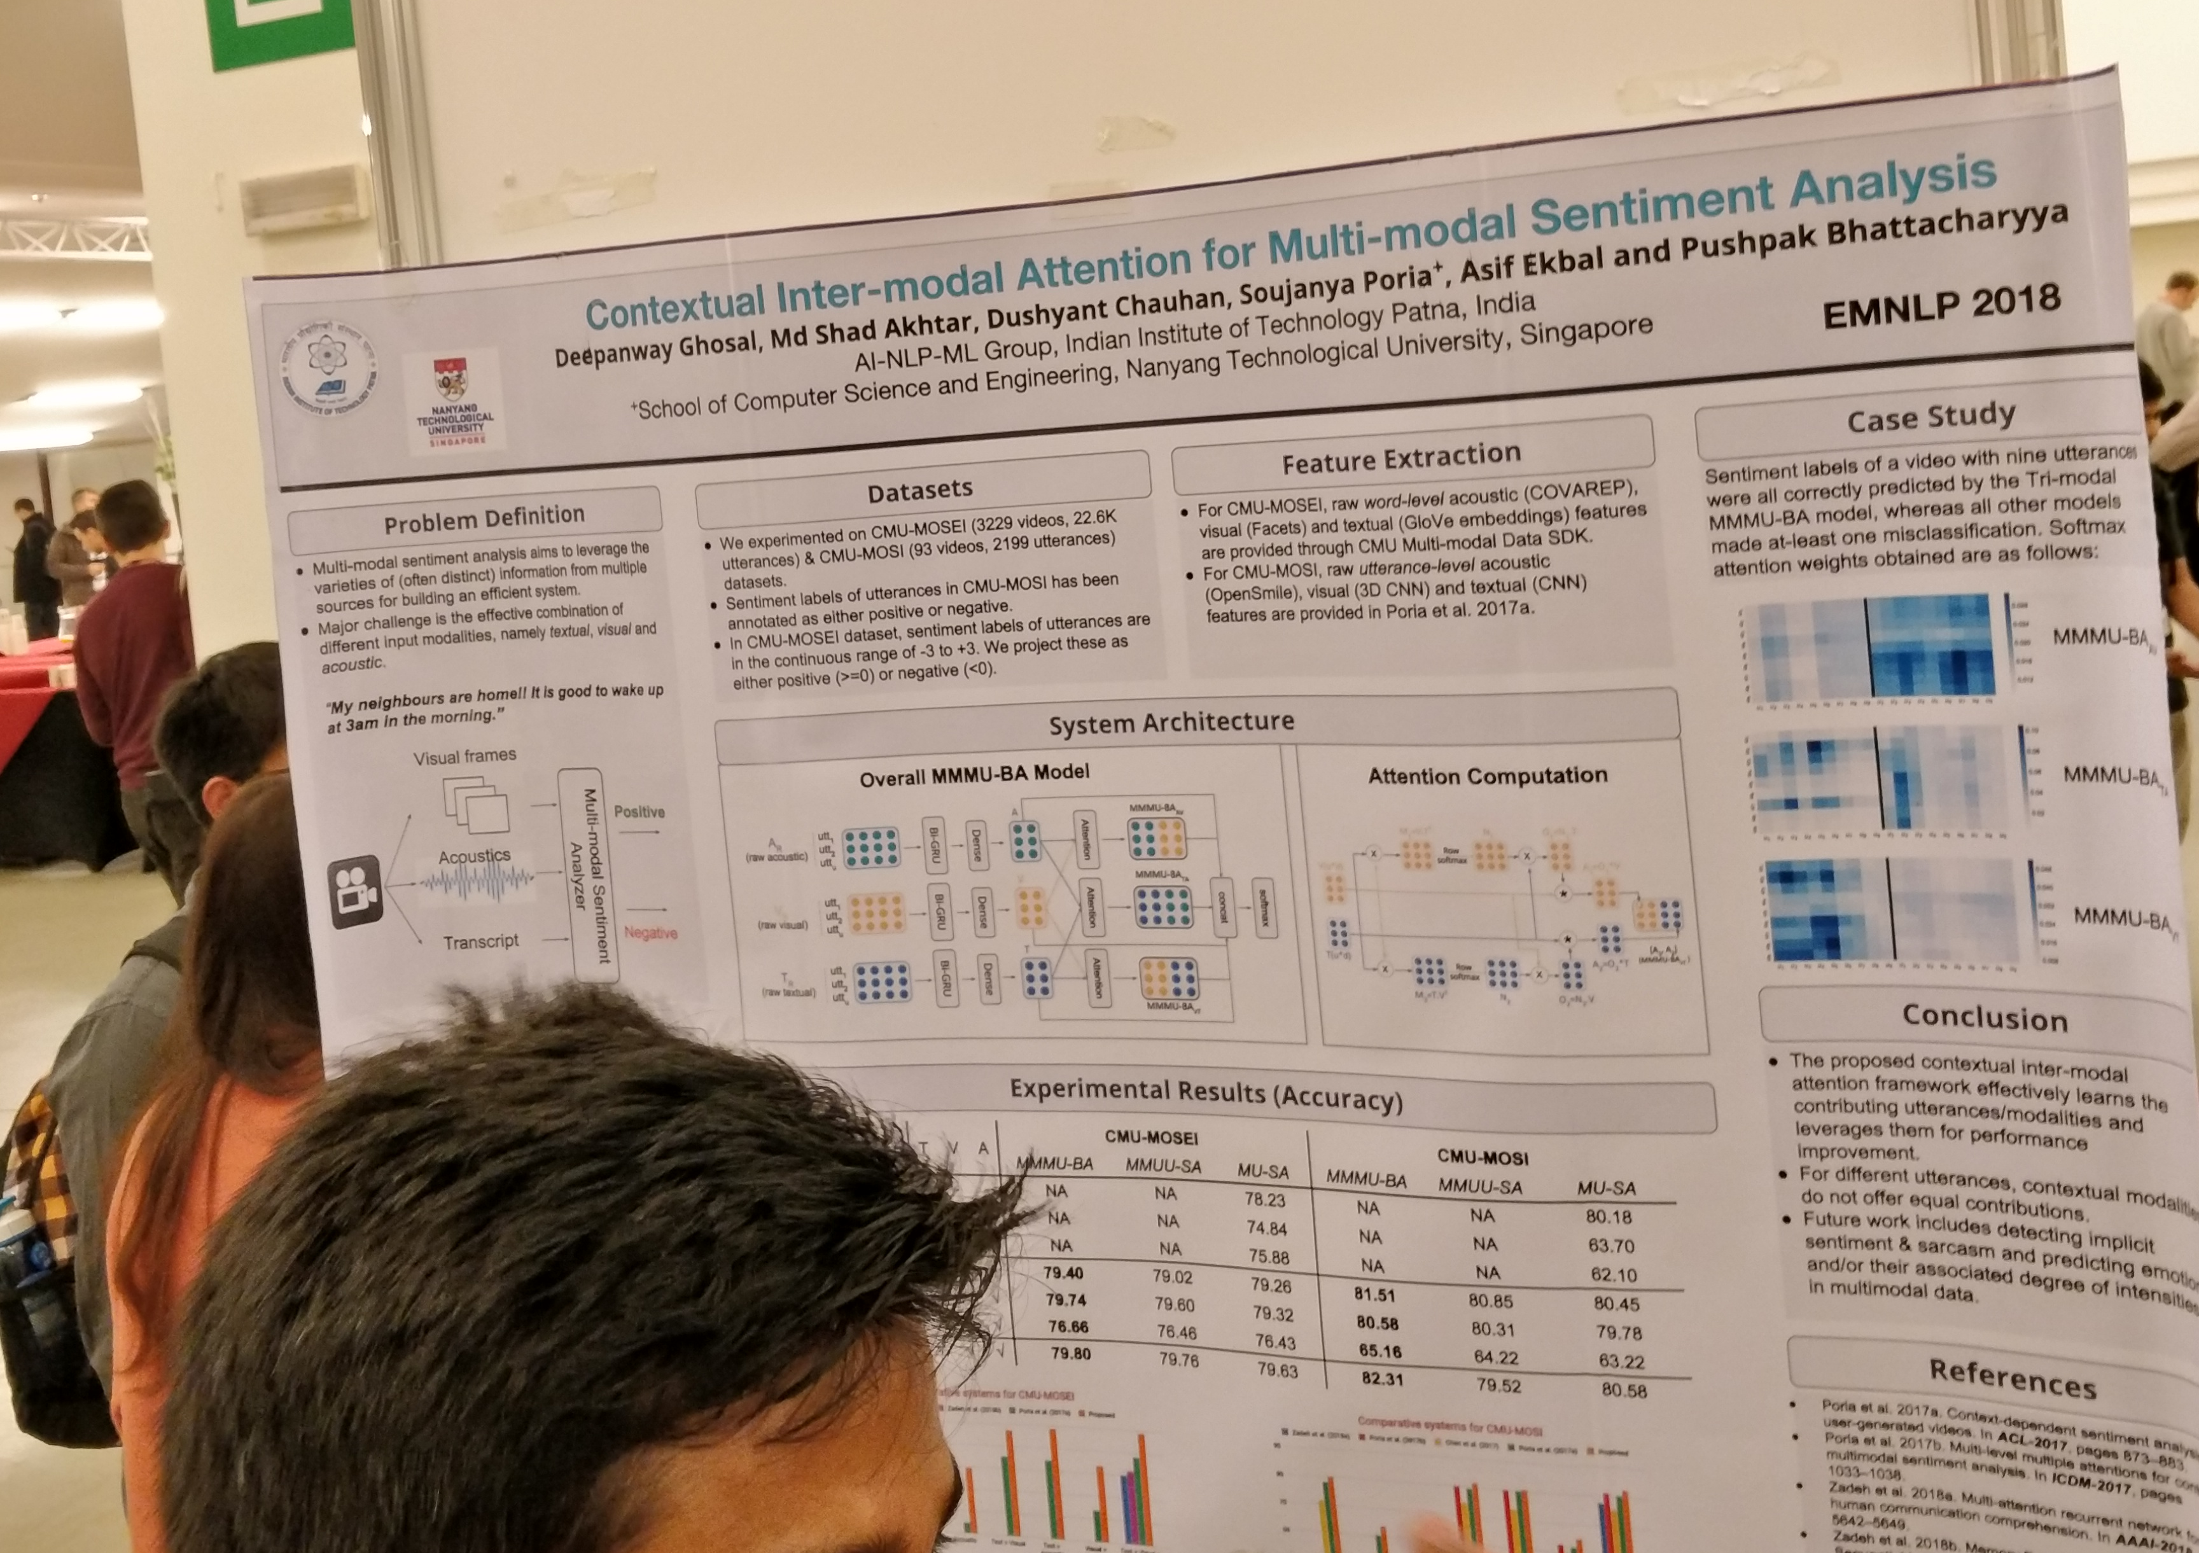
Sentiment Analysis
Poster session

Slide 13
Sentiment analysis towards QA
What?
Question-answer snippets where sentiment is sought and expressed.
How?
Self-matching attention layer
They use a bidirectional matching layer to allow specific aspect words to be included:
Embedding layer
BiLSTM layer
Question-to-answer attention and answer-to-question attention

Slide 14
Cross-topic argument mining
What? Integrating topic information into BiLSTMs is useful as compared to vanilla BiLSTMs
How?
Large annotated dataset
Topic information is incorporated into CLSTM, a contextual LSTM cell

Slide 15
Summarizing opinions
What?
Extractive summaries from multiple reviews.
Dataset of reviews, along with human-annotated summaries and aspect-specific scores.
How?
Multi-task learning for domain-specific extraction of aspects.
Multi-seed aspect extractor (Aspect words & related words -> encoder)
Multi-task learning to extract domains and aspect words
Multi-instance learning for opinion summarization

Slide 16
CARER: Contextualized affect representations for emotion recognition
What?
Represent an emotion corpus as a graph
Effectively capture the global linguistic variations
How?
Generate graphs based on sentences in an emotion-annotated dataset, a detailed pattern extraction
Using the graphs:
Feature extraction
Initialising the matrix of a CNN

Slide 17
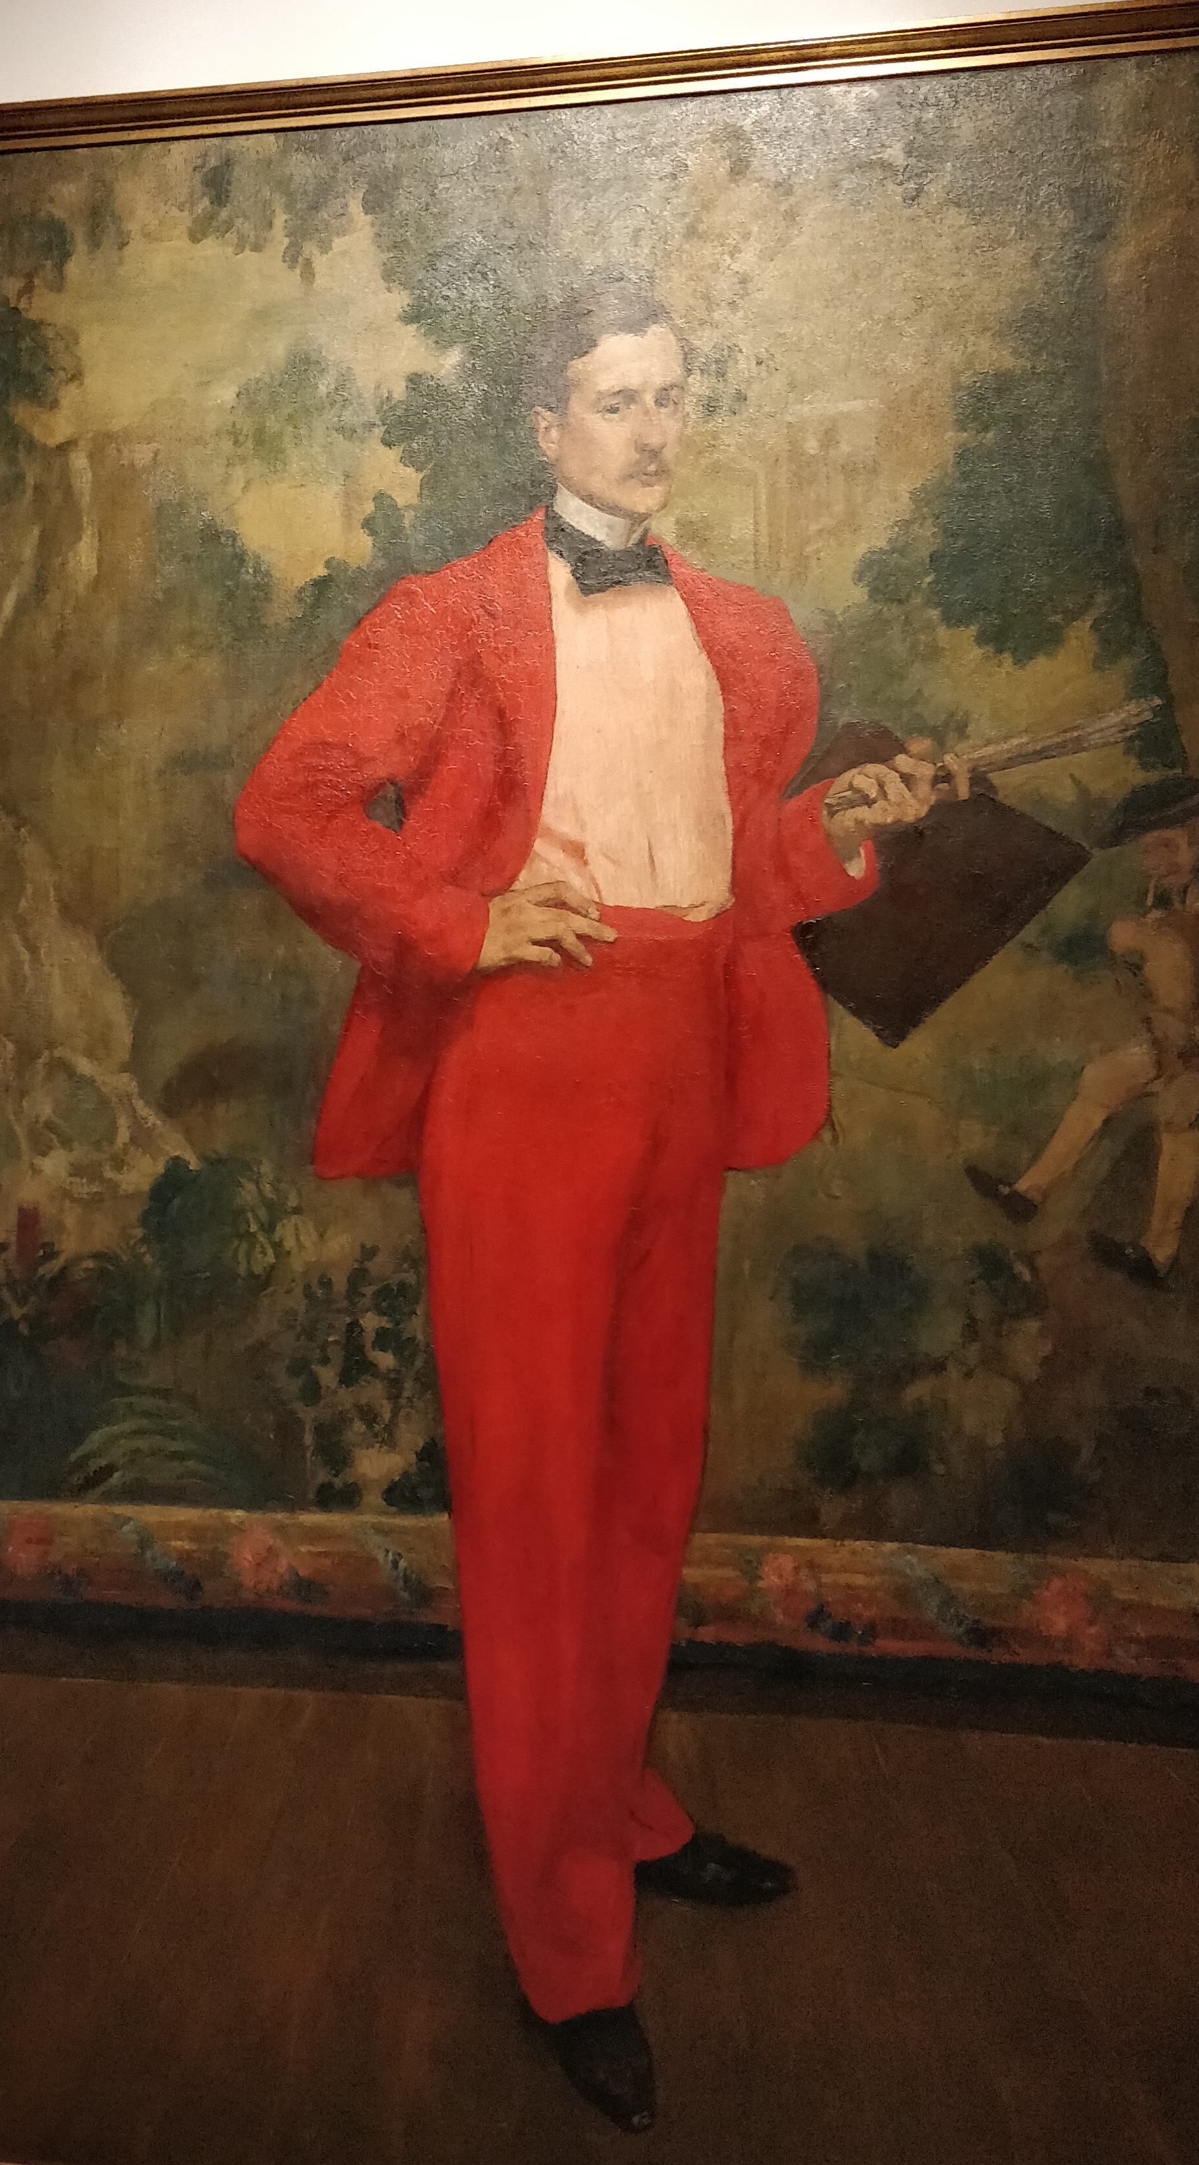
AI for Social Good
A painting at the social event venue

Slide 18
Aggression and loss reported by gang-involved youth
Gangs on social media reporting aggression and loss
Focus on African-American youth living in communities rife with violence
Aggression (yes/no), loss (yes/no)
Features based on domain-specific word embeddings

Slide 19
It’s going to be okay
Question: Is it better to reveal gender online to get support?
Seems like a set of assorted classification tasks. Polite or not, supportive or not, etc.
‘Gender performance’
Task 1: Predict gender using usernames
Task 2: They download a set of posts, predict them as polite response or not. Supportive response or not.
Then they break it down in terms of gender. Did the post get support?
Key observation: women get more support but also face more attacks

Slide 20
Detection of type of sexual harassment
What?
Given a sexual harassment report, can the type of harassment be predicted?
Can what these classifiers learn tell us about natures of harassment?
How?
Safecity is a portal where women self-report and assign labels to type of harrassment
Single label models (based on svm, CNN and RNN) and multi label models (based on svm, CNN and RNN)
Lots of interesting analyses of the output. What words are important for labels, what are word similarity, time/abuser of harassment etc.

Slide 21
Gender bias in abusive language detection
What?
False positive bias
‘woman’ ‘muslim’ -> abusive language
They first show that there is model bias due to gender
Datasets of sexist and abusive tweets
Create a dummy evaluation dataset of test instance pairs with gender terms different (“he is cunning”/”she is cunning”, “he is intelligent”/”she is intelligent”) Three
How?
Three mitigation approaches:
debiased word embedding: Initialisation with different pre-trained embeddings,
Gender swap data augmentation: In the training set, generate dummy examples (as in the dummy set)
First train with a larger source corpus with similar task, then fine-tuned on test corpus with bias.

Slide 22
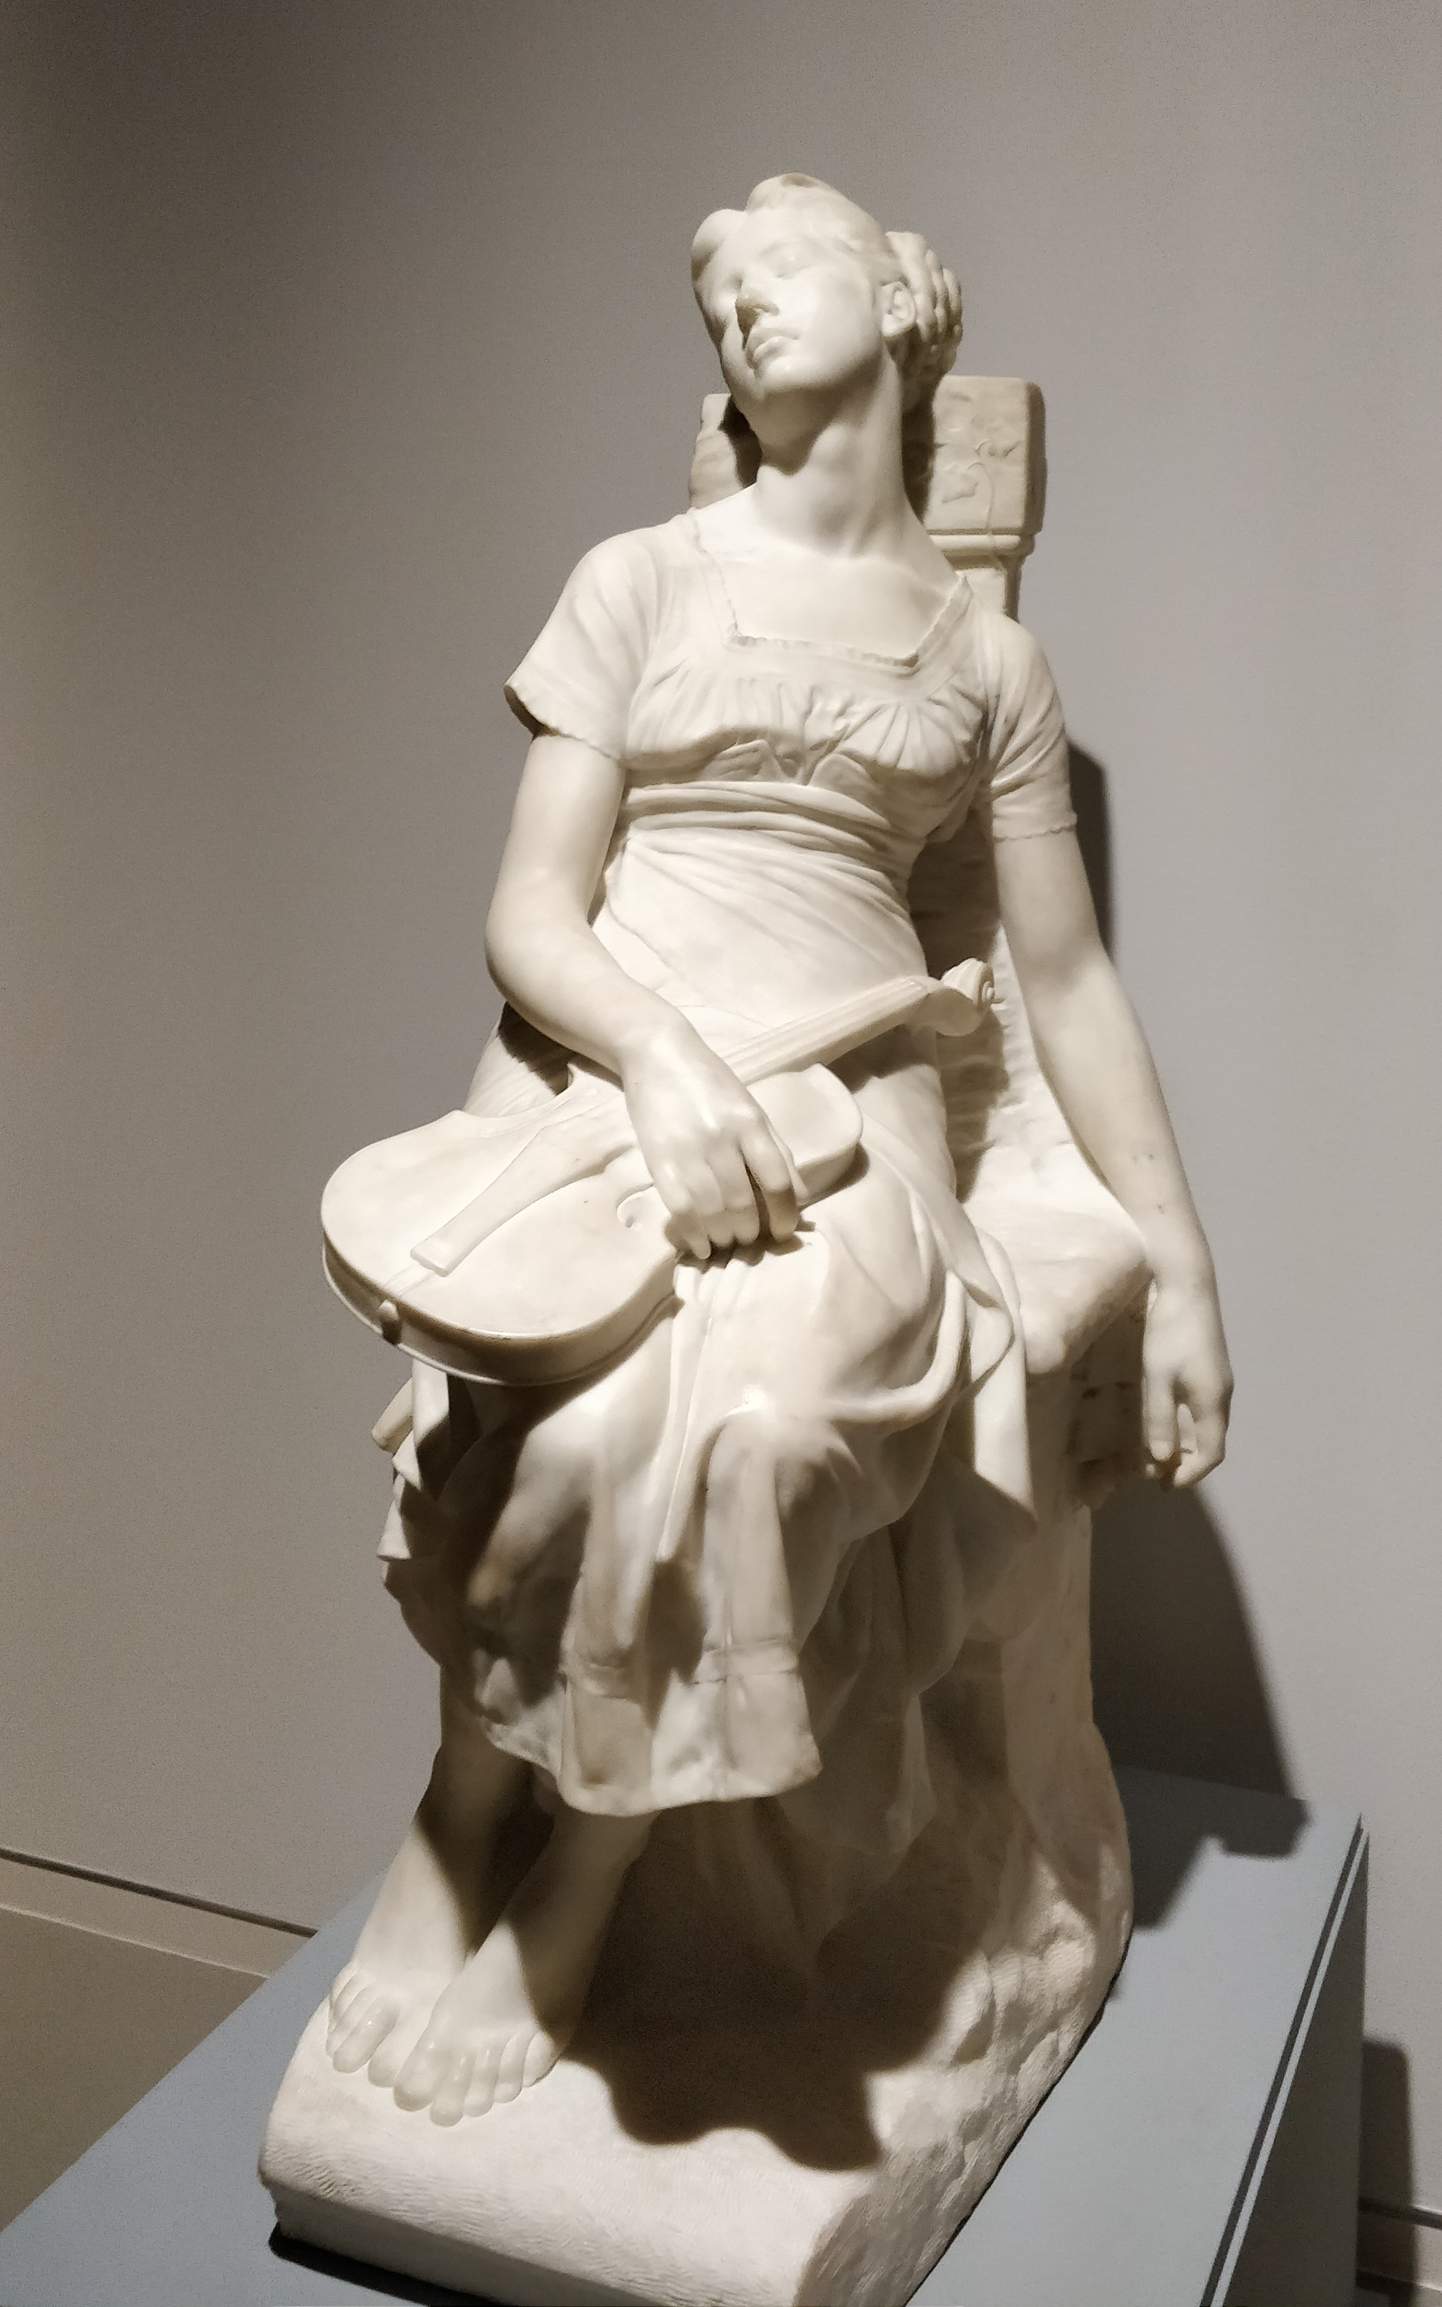
Other Papers
A sculpture at the social event venue

Slide 23
Figurative language
Idiomatic usage detection
Given a sentence, can you detect if it is idiomatic or literal.
An idiom -> Content words -> Find similar words -> Use heuristics to assign soft labels to list of sentences that contain the idiom -> Use LDA to generate distributions (for two topic labels: literal/idiomatic)
Exaggeration detection
Dataset of sentences marked as hyperbolic and non-hyperbolic
Publicly available
Qualitative features
Compares different combinations of features

Slide 24
Privacy in semantic representations
What?
Embeddings capture properties that can be used for several classification tasks
Do they capture properties corresponding to private attributes?
Two papers:
Privacy preserving neural representation [1]
Can demographic attributes be predicted using neural reps? [2]
How?
Adversarial learning to predict protected attributes.
In [2], a classifier predicts emoticons/emojis from text. An adversarial learner takes the final state of the LSTM and tries to learn predicting gender of the author.

Slide 25
DeCLarE: Validation of news based on web pages
What?
Input: Sentence (claim)
Evidence is a set of web pages extracted using a web search API.
https://gate.d5.mpi-inf.mpg.de/credeye
Output: Is the claim true?
How?
Get top k articles relevant to a claim (based on entities and heuristic-based filtering)
Claim + Evidence embeddings.. LSTM layers + attention
Evidence embeddings… LSTM layers + attention
Article source embeddings
Concatenate.. Dense Layers

Slide 26
Coming to your senses
Are sense embeddings a good proposition?
The paper examines several questions: (a) If averaging similarity over senses is a good idea, (b) If sense embeddings need to be evaluated on the right task, (c) If quality of annotations are important for quality evaluation of embeddings
(From the paper) Until a reliable evaluation test exists, research on polysemic word representation is seriously hampered. In fact, a re-evaluation of past models would be in place, as both ‘positive’ and ‘negative’ results that were previously reported are in fact invalid.

Slide 27
Extreme summarization
What?
“Don't give me the details, tell me a one sentence summary.”
Abstractive summarisation
Dataset: BBC news articles have a one line heading... And a body.
So, the body is the input and one line heading is the output
How?
seq2seq summarization
Topic-aware convolutional model.
Word embeddings and position embeddings
Convolutional representation for the document and summary
In addition to ROUGE, QA-based Human evaluation: Informativeness, well-formedness

Slide 28
Question-Answering datasets (1/2)
Exam dataset: CLOTH dataset, Set of questions and answers
QA dataset using Wikipedia: HotpotQA
With supporting facts.
The questions are of diverse types, contain different kinds of answers.
The baseline model is an attention based model.

Slide 29
Question-Answering datasets (2/2)
Multi hop question answering using an "open book" of scientific facts.
OpenBookQA
A dictionary of open-book facts and supervision from KB such as wordnet – used collectively to answer questions. Baselines reported.
Validating theory of mind using question answering
Interesting validation of beliefs based on a set of sentences.
“A entered the kitchen. B entered the kitchen. Milk is in the fridge. A left the kitchen. B moved the milk from fridge to pantry. B left the kitchen. A entered the kitchen. Where will B look for milk?”
Pantry or the fridge? “Belief states”

Slide 30
Posters (1/2)
Learning language models from code-mixed data: Uses a switch variable and learns separate LSTMs for each language. Mandarin-English
Native language identification: Based on a person’s ‘chunk of reddit posts’, can you predict their native language? Datasets consist of European users.
Automatic detection of ‘vague’ words in policies: Modeled like a WSD task
Demo: Given the abstract and title of a paper, generate the title of a science journalism article (seq2seq)

Slide 31
Posters (2/2)
Demo: Visualisation of attention weights for a trained model.
BLEU is no good for text simplification: A manual corpus is created for text simplification.. and then correlated with BLEU. Shows poor correlation
Detecting well-formed natural questions: A dataset, and then a detection system, to detect if a question is well-formed or not
Coherence-aware neural topic modelling: In addition to hyperparameters, explicitly optimise topic coherence during training
Topic intrusion to evaluate topic models: Automatic method to evaluate topic intrusion (rogue word inserted in topic words). Input is document and a set of topics

Slide 32
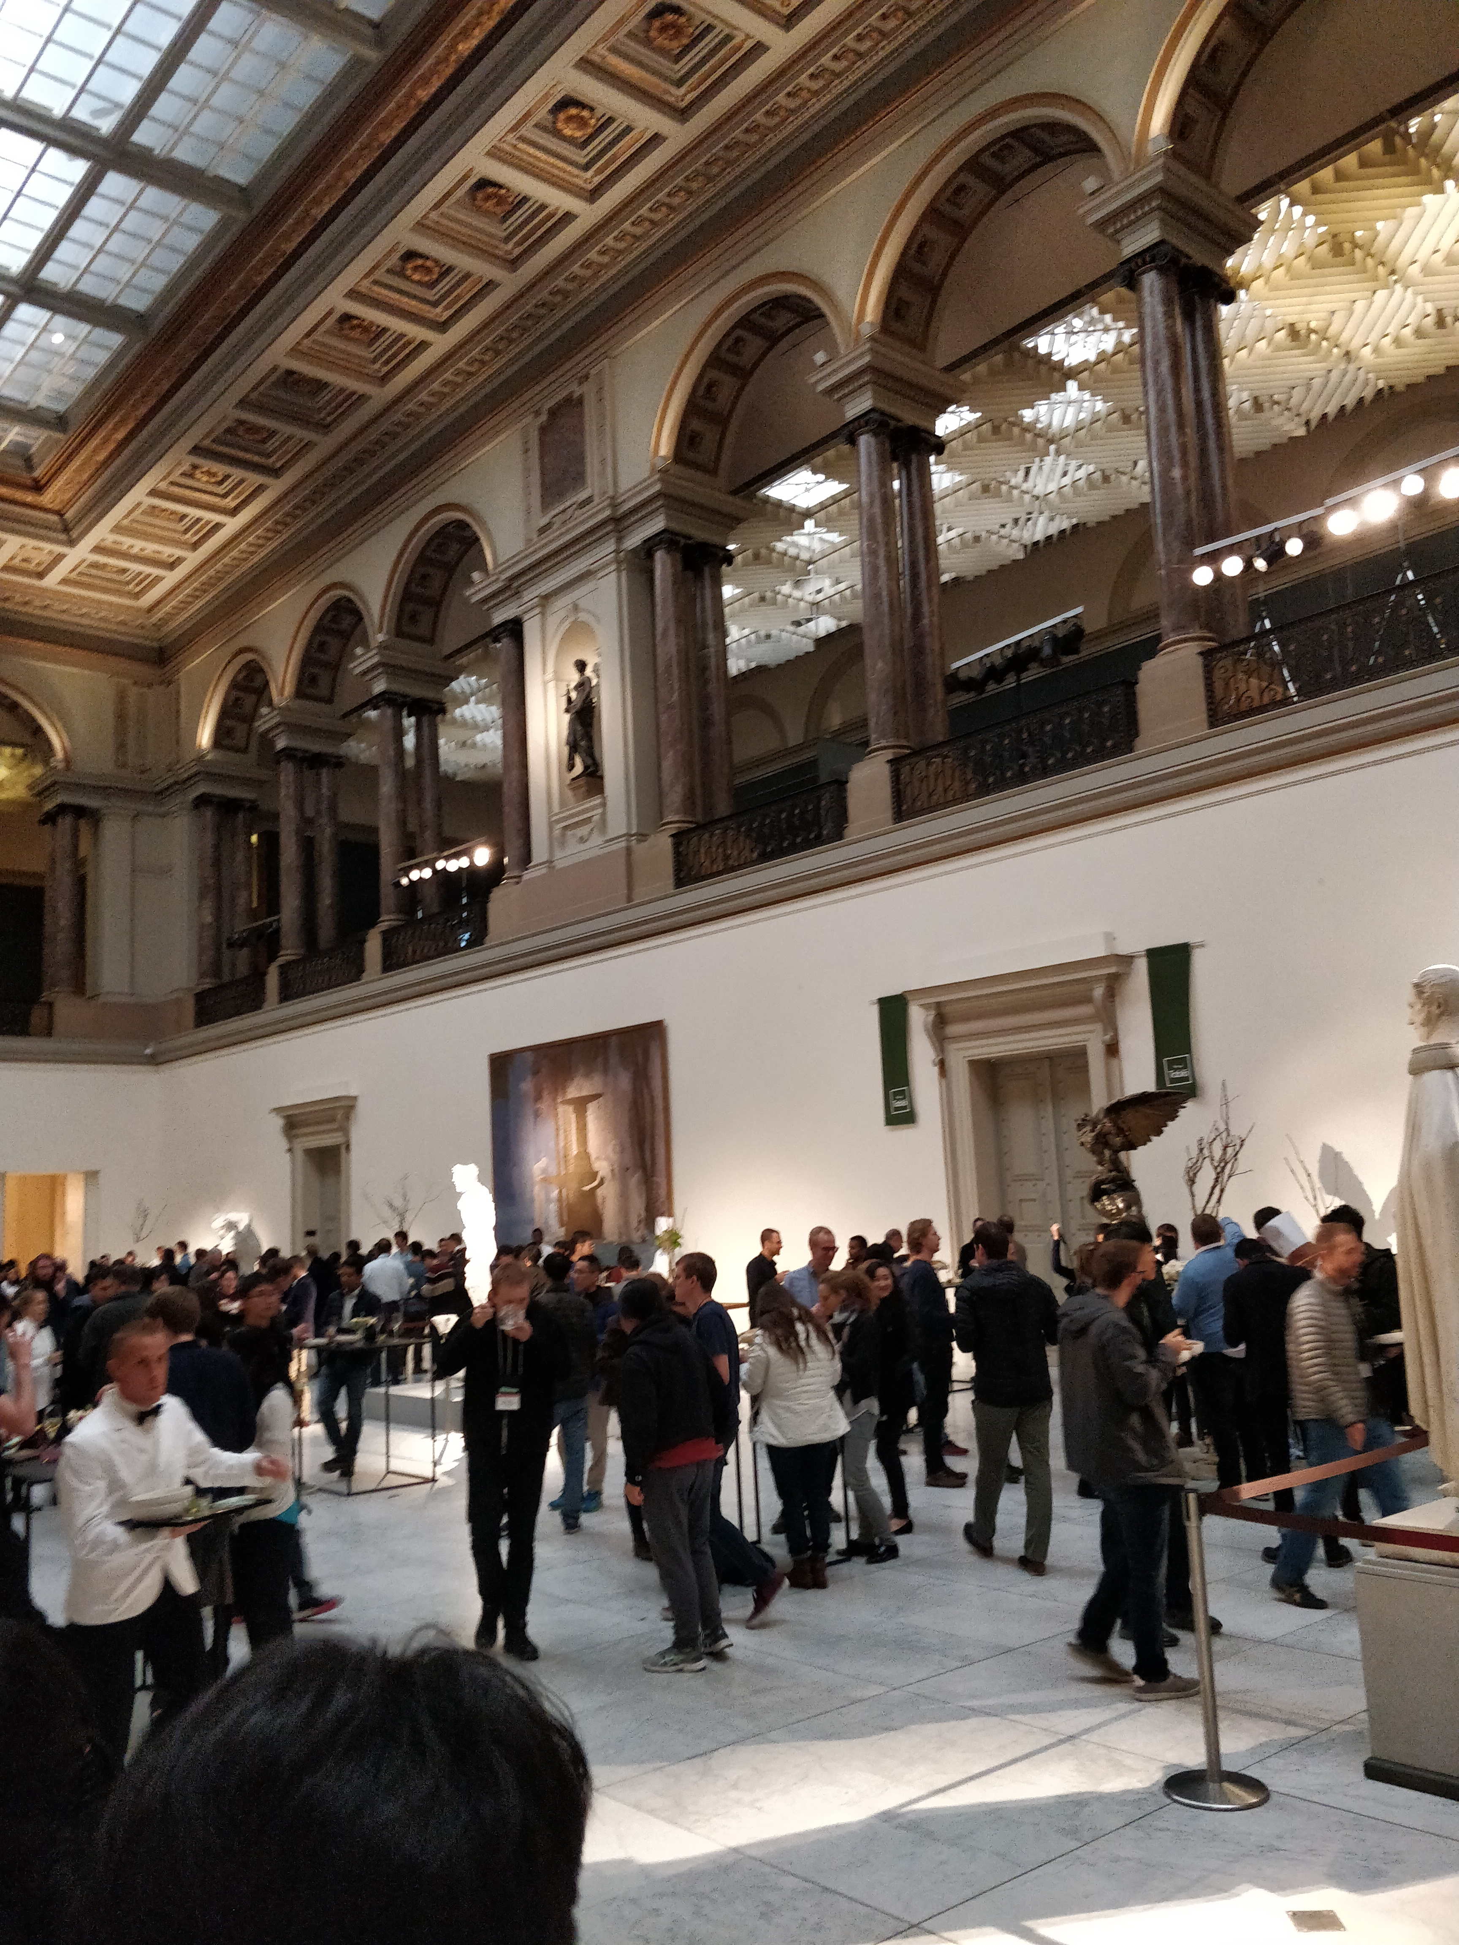
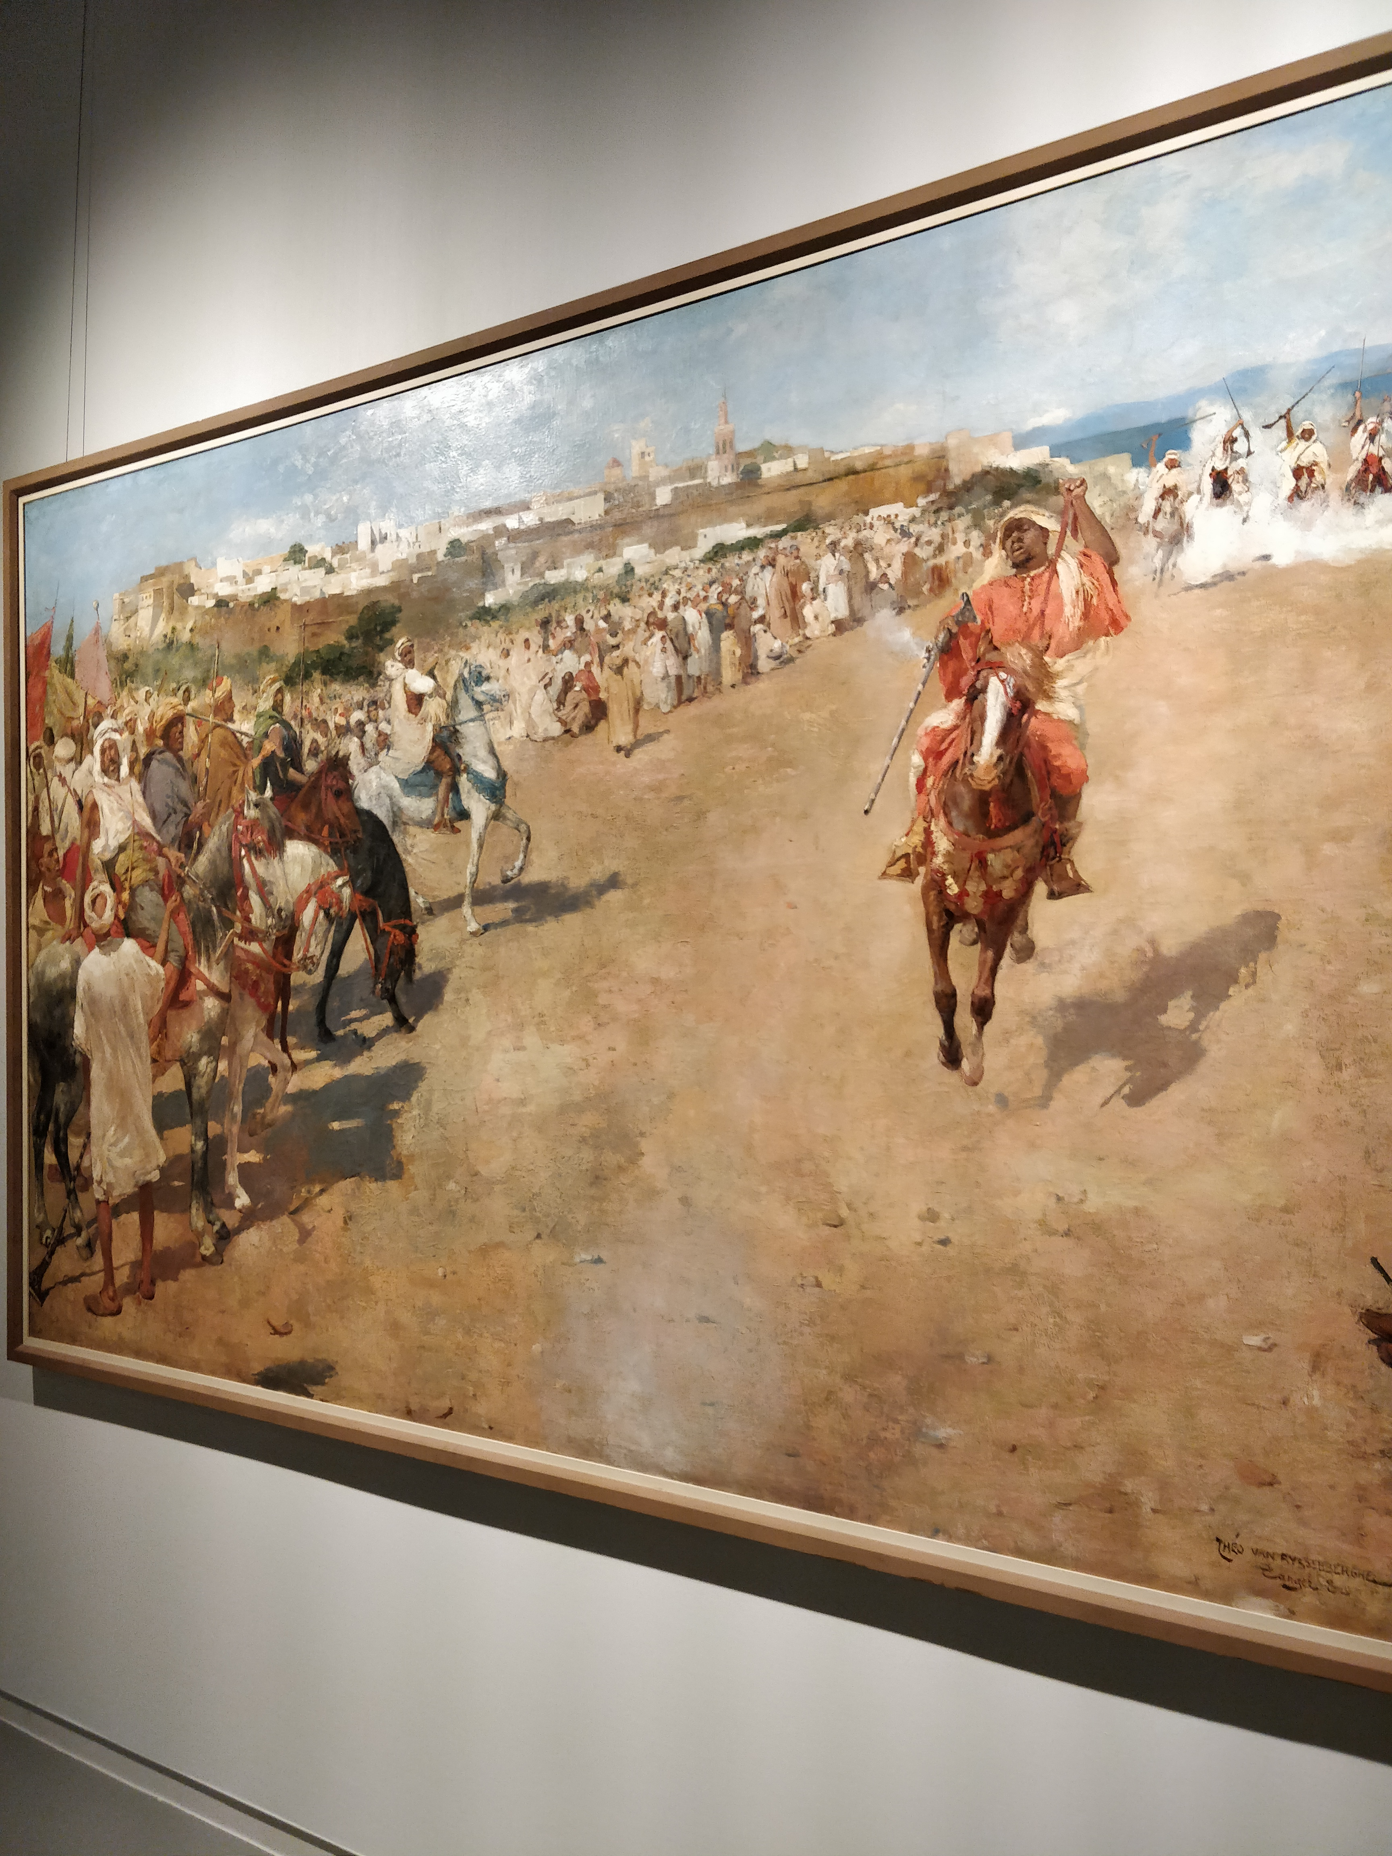
Social Event at the Museum
A painting at the social event venue

